Slide 1
Frequencies in Music
Juan Castaneda, Mohamed Salama

Slide 2
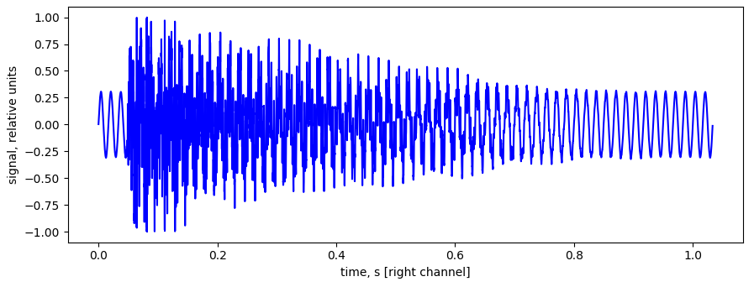
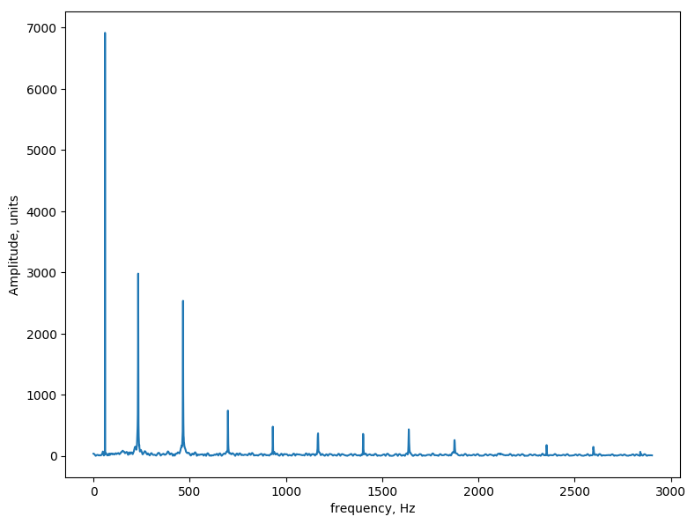
From Lab 6

Slide 3
What is Consonance/Dissonance?
Consonant Interval: Fundamental frequencies are related by a simple ratio
Dissonant Interval: Fundamental frequencies are related by complex ratios
Simpler ratio sounds better
Notes:
Smooth/pleasant vs unpleasant

Slide 4
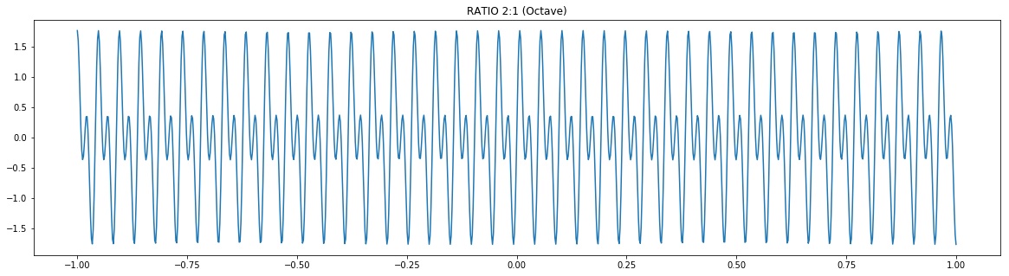

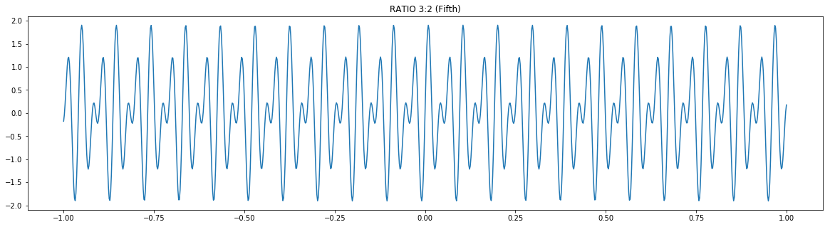
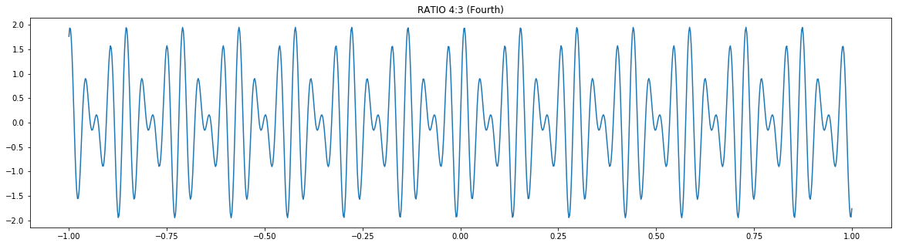
2:1
Octave
3:2
Fifth
4:3
Fourth
Notes:
All Consonant

Slide 5
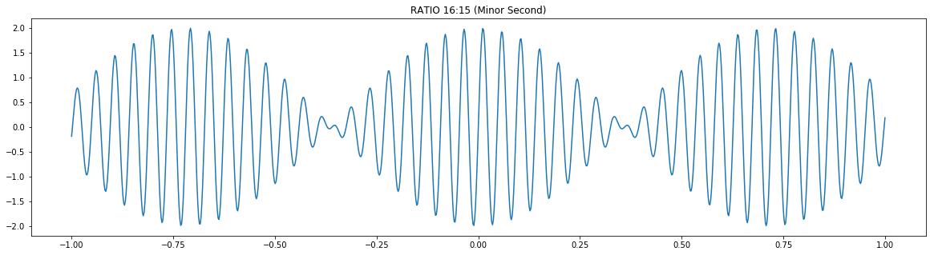
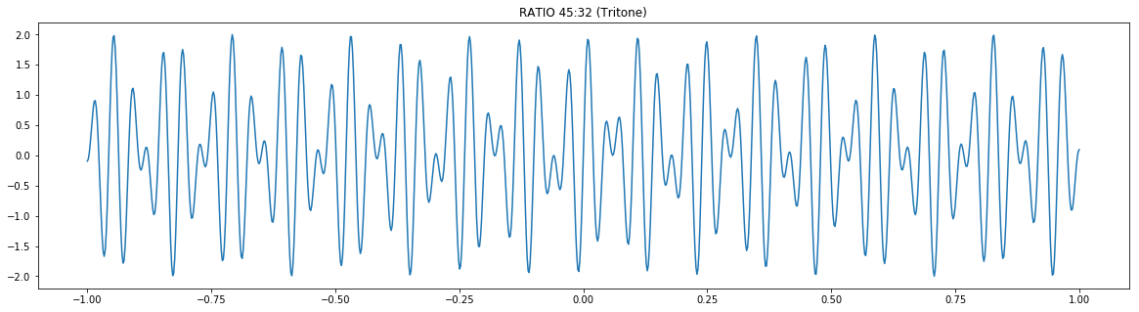
16:15
Minor Second
45:32
Tritone
Notes:
All Disonnant

Slide 6
Our Code (steps):
Read the chord audio
Fourier Transform
Remove overtones + find 3 fundamental frequencies
Not always ‘true’ fundamental
Identify notes → Identify chord
Generate scale from chord
Create the melody
Using probabilities (based on interval ratios)

Slide 7
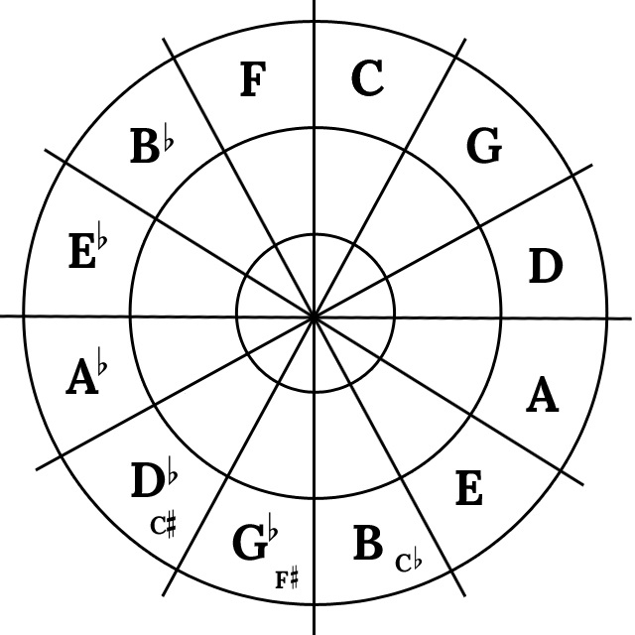
Finding scale from root note
C scale = [C,D,E,F,G,A,B]
Notes:
Db, Gb dissonant.. Rest is consonant

Slide 8
Melody
BEST
[0,0,0]
[0.1,0.2,0.3]
Probabilities:
[1,1,1]

